Slide 1



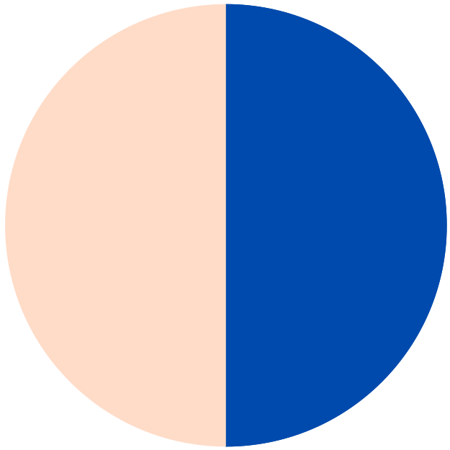



Automation Testing of My Store

Slide 2



Project Objective
Automate UI tests for http://automationpractice.multiformis.com/index.php
The goal of this project is to automate UI tests for http://automationpractice.multiformis.com. By validating critical user journeys such as the contact form, product search, and homepage, we aim to enhance the overall user experience. This initiative will also support Continuous Integration (CI), ensuring a more efficient and reliable testing process.

Slide 3

Why NightwatchJS?
Benefits of using E2E framework
NightwatchJS is a powerful end-to-end testing framework that utilizes JavaScript and Node.js. It allows for seamless integration of tests in your CI pipeline. The page object model enhances code maintainability and reusability, while the support for headless Chrome simplifies browser interactions. Overall, using NightwatchJS leads to more efficient and reliable testing processes.

Slide 4



Node.js
Node.js enables server-side scripting; it allows for efficient handling of asynchronous operations, crucial for automating tests.
Tech Stack and Tools
NightwatchJS
NightwatchJS is an end-to-end testing framework that simplifies UI testing using JavaScript and supports the page object model for better test organization.
Overview of essential technologies used in the project
ChromeDriver
ChromeDriver facilitates browser automation by enabling NightwatchJS to control Chrome, making it essential for running tests in a real browser environment.
CircleCI
CircleCI is a continuous integration tool that automates testing workflows, ensuring that tests run seamlessly on every code change for reliable deployment.

Slide 5


Project Structure Overview
Directory Breakdown
The main directories include tests, pages, and config; each serves specific purposes to streamline the testing process and maintain organization within the project.
File Organization
Files are organized by functions, such as page objects for UI elements and test scripts for different user journeys, ensuring clarity and easy maintenance.
Configuration Files
Configuration files set up the environment, including NightwatchJS settings, test runner options, and integration with CI/CD tools for seamless automation.

Slide 6





Highlights of the Implementation
Configuration is essential for effective testing; here are test examples for the contact form, product search, and smoke tests to demonstrate the framework's capabilities.

Slide 7
Example Test Flow
Testing the contact form and file upload
The test flow for the contact form involves validating input fields and handling file uploads. When a user submits the form, the tests check for successful submission and appropriate error handling. This ensures that the application meets user expectations and provides a seamless experience. Additionally, the automated tests help maintain reliability across different updates.

Slide 8
Running the Tests
Local and CI commands explained
To execute the tests locally, use the command npm test after ensuring all dependencies are installed. For CI integration, configure your CI pipeline with the command npm run ci, allowing tests to run in a headless environment. This setup ensures consistent results across various environments while maintaining a robust testing framework.

Slide 9
Challenges Solved
Overcoming stability, selectors, and waits
In automation testing, stability issues can lead to inconsistent results. To address this, we implemented robust selector strategies to ensure reliable element identification. Additionally, we introduced effective wait mechanisms to manage timing issues, allowing tests to run smoothly and reducing false negatives in our test outcomes. These solutions have significantly improved our testing efficiency and reliability.

Slide 10


Sample HTML Report of Automation Testing
This report showcases the results of our automation testing efforts using NightwatchJS, detailing the success rate of various user journeys.

Slide 11
Comprehensive Regression Checks
Automation testing ensures thorough regression checks, helping to catch bugs early and maintain software quality throughout the development lifecycle.
Benefits of Automation Testing
Significantly Saves Time
By automating repetitive tests, teams can significantly save time, allowing developers to focus on new features and improvements rather than manual testing.
Exploring the key advantages of automated testing
Highly Extendable Framework
Automation frameworks are highly extendable, making it easier to integrate new tests and adapt to changes in the application without major rework.
Enhanced Test Coverage
Automated testing expands test coverage, enabling more scenarios to be tested in less time, which leads to a more robust application.

Slide 12
Thank You! Any Questions?
Automation Testing Benefits
Automation testing allows for quicker regression checks and increases efficiency, saving valuable time in the development cycle while ensuring high-quality software delivery.
NightwatchJS Advantages
NightwatchJS simplifies the testing process with its powerful E2E framework, leveraging JavaScript and Node.js to enable seamless integration and maintainability of tests.
Implementation Highlights
Key aspects of the project include configuration settings, well-structured page objects, and thorough test cases that enhance the effectiveness of UI testing for user journeys.

